Slide 1


RESERVE EATS
"Experience fine dining without the fuss"
HackNITR 4.0

Slide 2

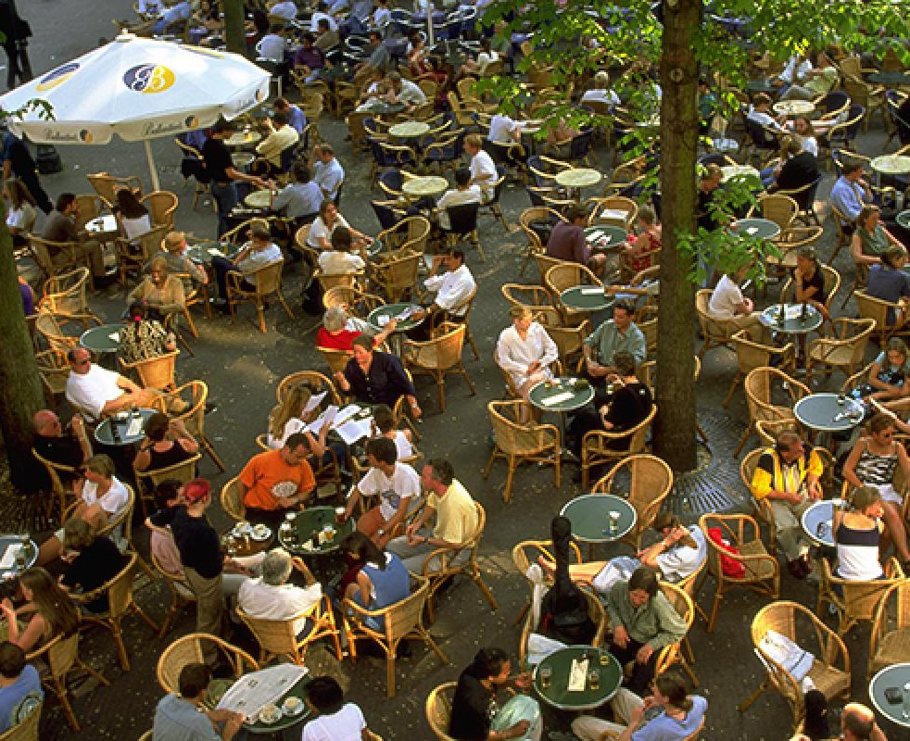
ISSUE
EMPTY STOMACH , BUT NO EMPTY SEAT !!!
When we plan to go out to eat, often we land at a crowded restaurant as we are unaware of the present crowd in the restaurants.
Then wait for a seat to be empty. Again wait for the food to be prepared.
Long waiting sucks ! ! !

Slide 3
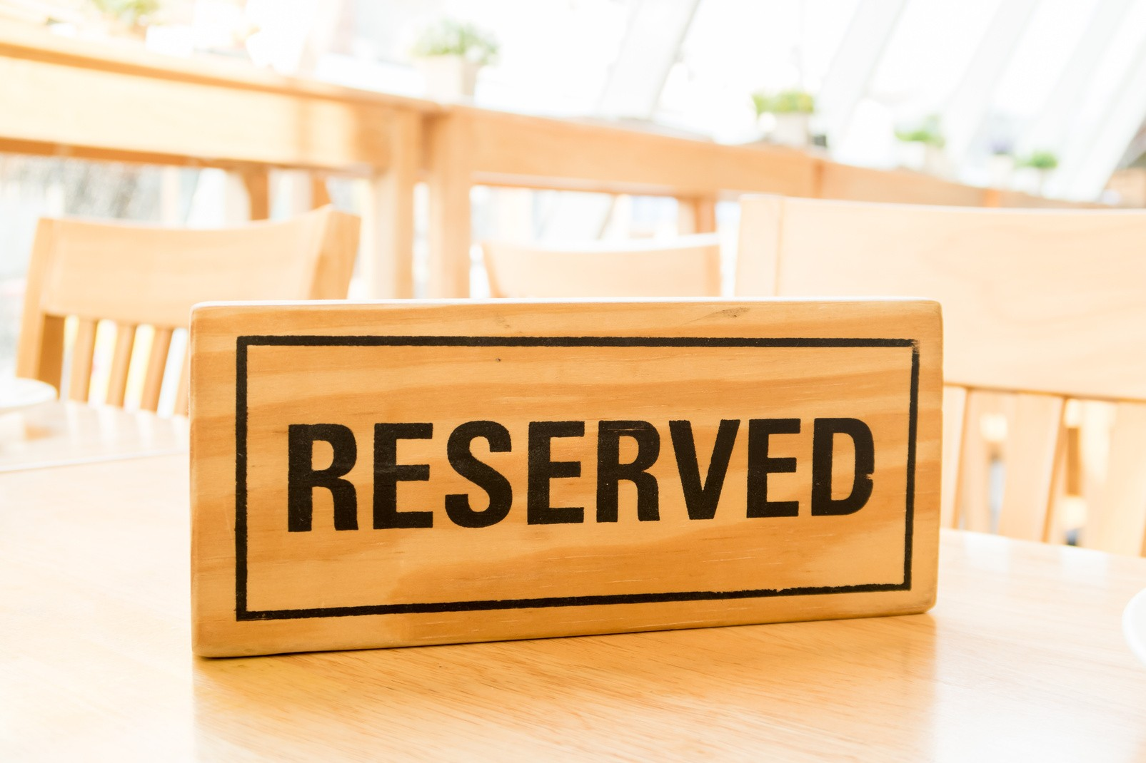
SOLUTION
For this problem we will build a web application through which prior booking of tables in the restaurants around the city will be possible .
It will show the present crowd in the restaurant .
Also the food menu and preparation time will be mentioned in the web application. The users will be able to book a seat and a meal from their home .
The web application will show an approximate time when the food will be ready .The users can reach the location accordingly . It will reduce the long waiting time.
There will also be an option for takeaway and home delivery.

Slide 4

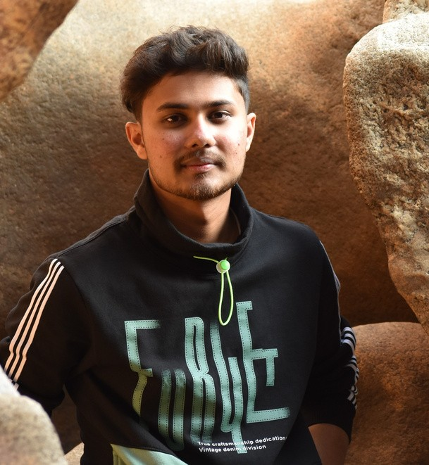
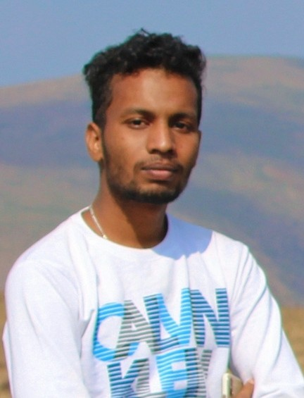
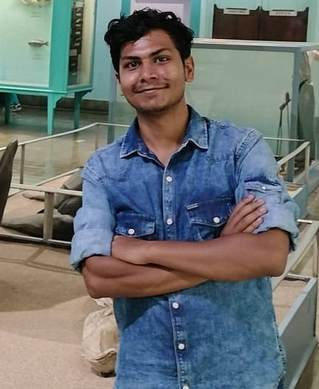
THANK YOU
TEAM MEMBERS :
SWASTIK KUMAR
SAHU
SHUBHAM SAHOO
ABHISHEK BALA

